Slide 1


Introduction To Computer
Binary Subtraction
Instructor:
Mohammad Hasan
B.Sc Engineering in CSE
Final Semester, Final Year.
Kryptonite Lab
Coding Flow

Slide 2
Binary Subtraction-
4 possibilities that we find
Subtraction
Result
Borrow
0 – 0 =
0
0
1 – 0 =
1
0
1 – 1 =
0
0
0 – 1 =
1
1
+1
0
- 1
10
1

Slide 3
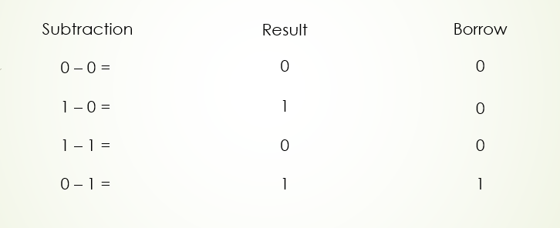
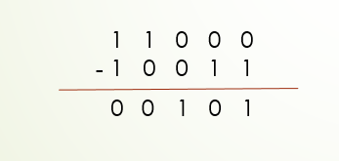
Binary Subtraction-
1
1
1
1 1 0 0 0
1 0 0 1 1
-
1
1
0
0
0
1
0
1
+1
+1
+1
1 + 1 = 1 0
Carry

Slide 4
Binary Subtraction-
0 . 1 0 1
1 0 . 1 0 0
-
1
0
.
0
0
1

